Slide 1


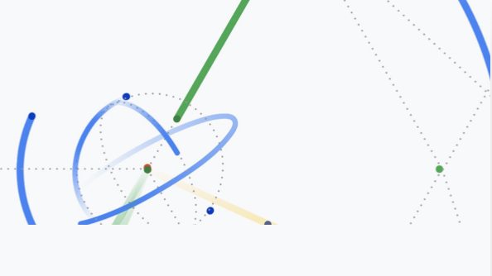
Artificial Intelligence
Machine Learning

Slide 3
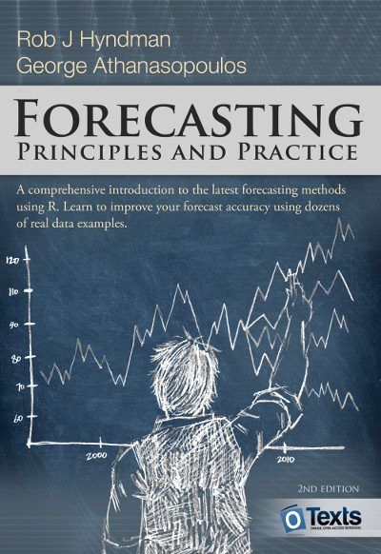
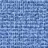
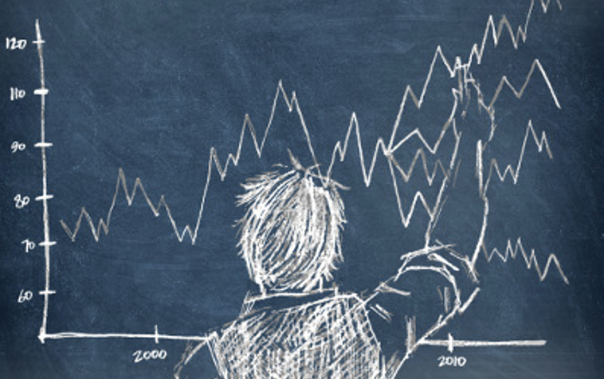
Time Series Analysis
Sada Narayanappa

Slide 4

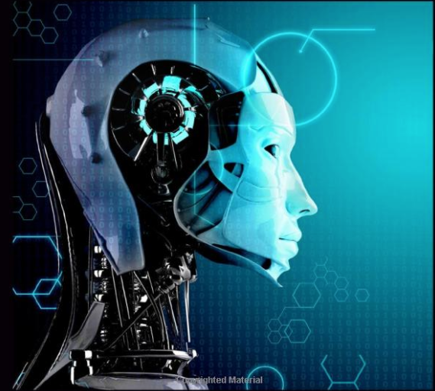
Artificial Intelligence
Machine Learning,
Data Science
Sada Narayanappa

Slide 5


